Slide 1
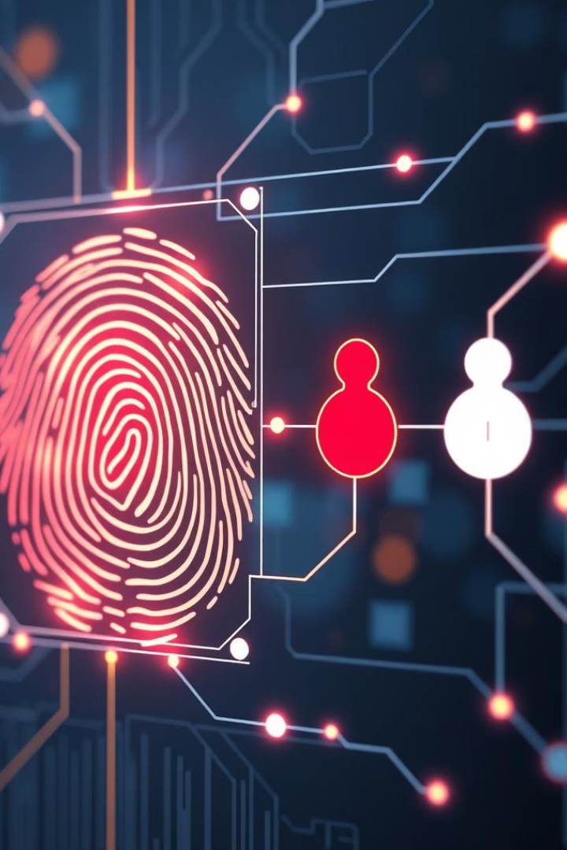


KRISHNA UNIVERSITY
COLLEGE OF ENGINEERING AND TECHNOLOGY
PROJECT Title: Non-Invasive Blood Group Detection using Deep Learning Model
Guide :
Dr. Md. Ali Mirza Sir
Team Members:
K. SAI RAM (Y21CSE279056)
K. PRAVEEN KUMAR (Y21CSE279047)
K. RADHA KRISHNA (Y21CSE279048)
CH. DILEEP KUMAR (L22CSE279003)

Slide 2
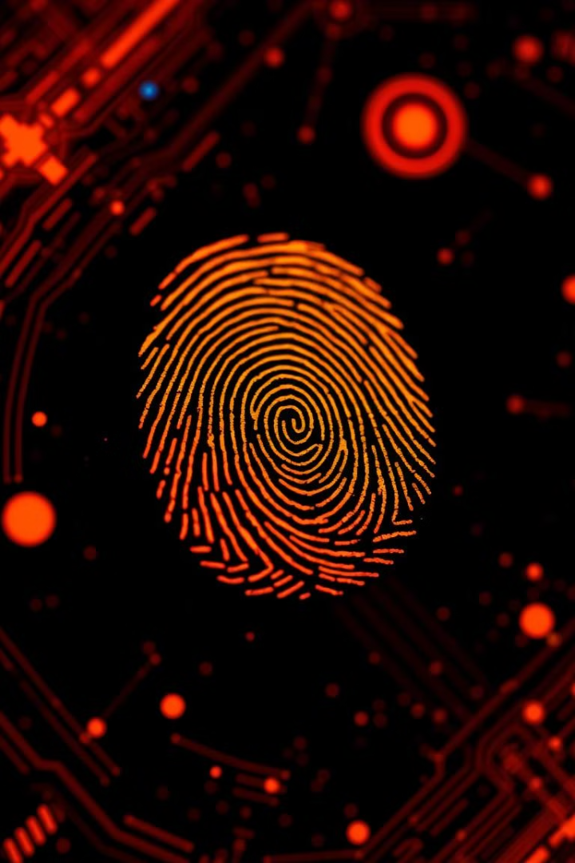

Fingerprint-Based Blood Group Detection: A Deep Learning Approach
This presentation explores a novel system that uses Convolutional Neural Networks (CNNs) for non-invasive blood group detection through fingerprint analysis. The approach leverages CNNs' powerful image processing and pattern recognition capabilities to identify blood types from fingerprint patterns. Despite challenges like the need for large labeled datasets and complex architectures, this research aims to improve accuracy and reliability beyond existing methods.

Slide 3


The Challenge of Traditional Blood Group Detection
Invasiveness
Traditional blood group detection necessitates invasive blood sample collection, causing discomfort and potential infection risk.
Time-Consuming
Laboratory tests can take significant time to process and interpret, delaying crucial medical decisions.
Resource-Intensive
Specialized equipment and trained personnel are required, limiting accessibility in resource-poor settings.

Slide 4
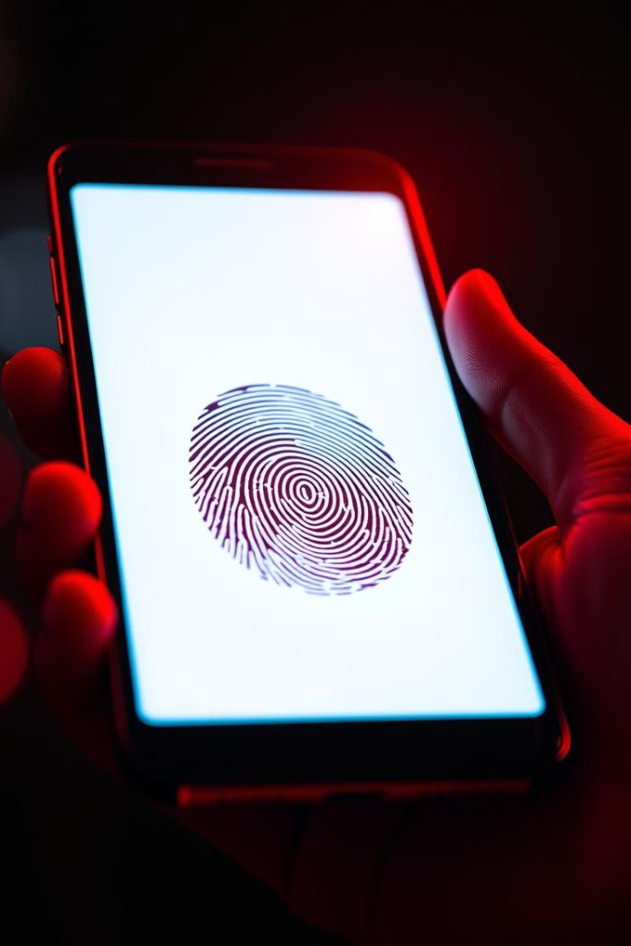
A Vision for a Non-Invasive Future
1
Fingerprint-Based Detection
2
Deep Learning Power
A Convolutional Neural Network (CNN) is trained to analyze fingerprint patterns and predict blood groups with high accuracy.
Leveraging the ubiquitous availability of fingerprint images, this approach aims to detect blood groups directly from fingerprints.
3
Accessibility and Efficiency
This method holds the potential for rapid, cost-effective, and accessible blood group determination in various settings.

Slide 5





Understanding the Data: Fingerprint Images
1
Image Collection
Image Preprocessing
2
Normalization, resizing, and augmentation enhance data quality.
Feature Extraction
3
CNN layers extract relevant fingerprint features for classification.
Blood Group Prediction
4
The model learns to identify blood groups based on extracted features.

Slide 6
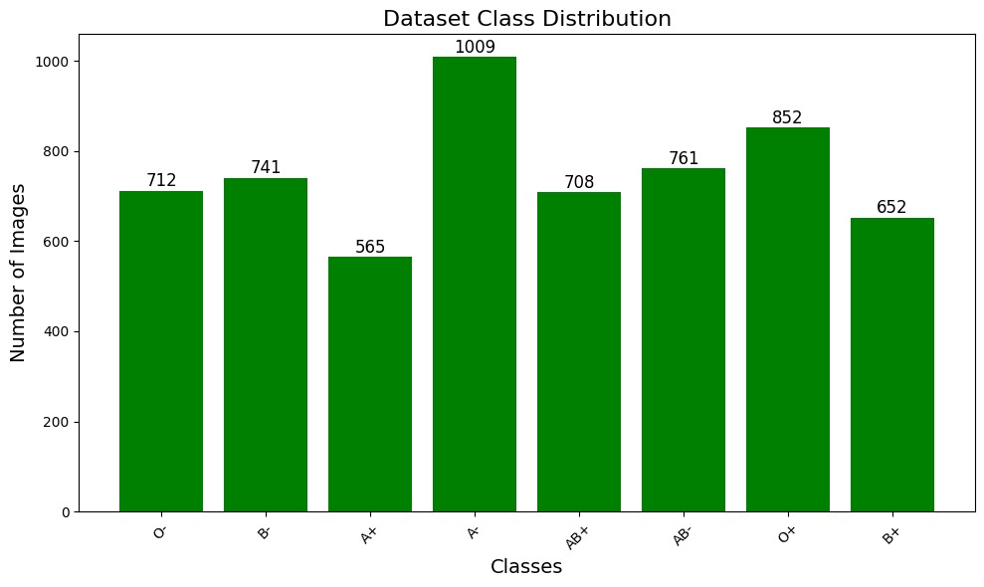


Blood Group dataset Distribution-

Slide 7
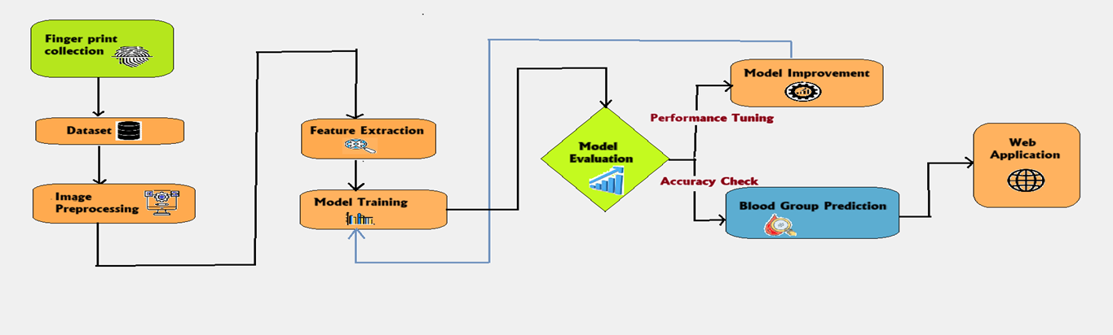






Architectural Overview
Fingerprint Data Collection & Preprocessing
Collect fingerprint samples using sensors or scanners.
Build a structured dataset.
Apply image preprocessing techniques (e.g., noise removal, contrast enhancement) to improve data quality for feature extraction.
Model Optimization & Blood Group Prediction
Apply performance tuning
Check accuracy and improve model if needed.
Once optimized, the model predicts the blood group from the fingerprint input.
Feature Extraction from Fingerprints
Extract key fingerprint patterns (minutiae, ridges)
Convert raw fingerprint data into meaningful numerical features usable by machine learning algorithms.
Web Application Deployment
Integrate the trained model into a user-friendly web application.
Enables real-time blood group prediction from fingerprint input via a browser-based interface.
Integration with Light Weighted Framework -Flak
5
Model Training & Evaluation
Train a machine learning model using extracted features.
Evaluate performance using metrics like accuracy, precision, and recall.
Use evaluation results to determine model readiness or need for improvement

Slide 8
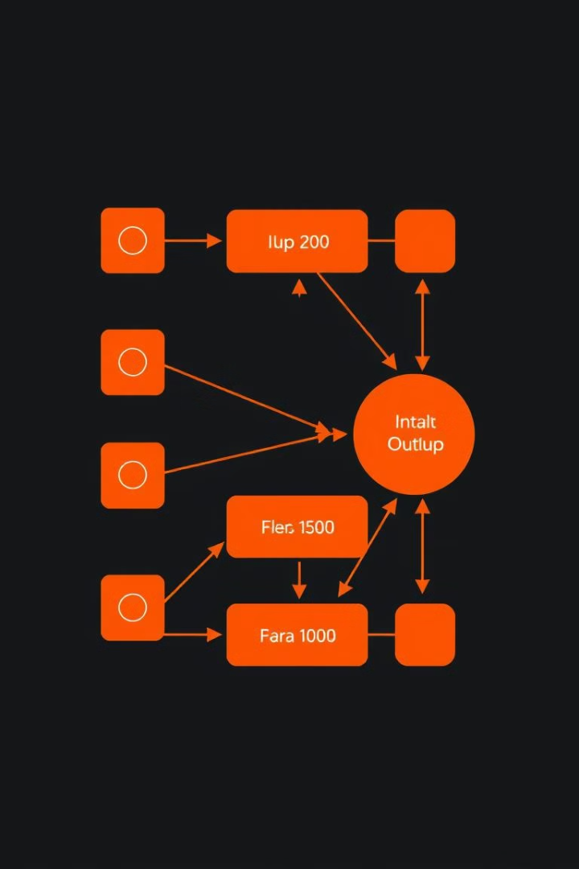




The Convolutional Neural Network: A Key Component
Convolutional Layers
Pooling Layers
Fully Connected Layers
Extract features by applying filters to input images.
Reduce dimensionality and extract important information.
Perform classification by mapping features to blood group labels.
CNN Technology
Challenges include high processing demands, complex network design, and the scarcity of large, precisely labeled fingerprint datasets.
CNNs are effective for fingerprint-based blood group detection due to their ability to learn intricate image patterns. Training on large annotated fingerprint datasets allows recognition of blood type correlations.

Slide 9
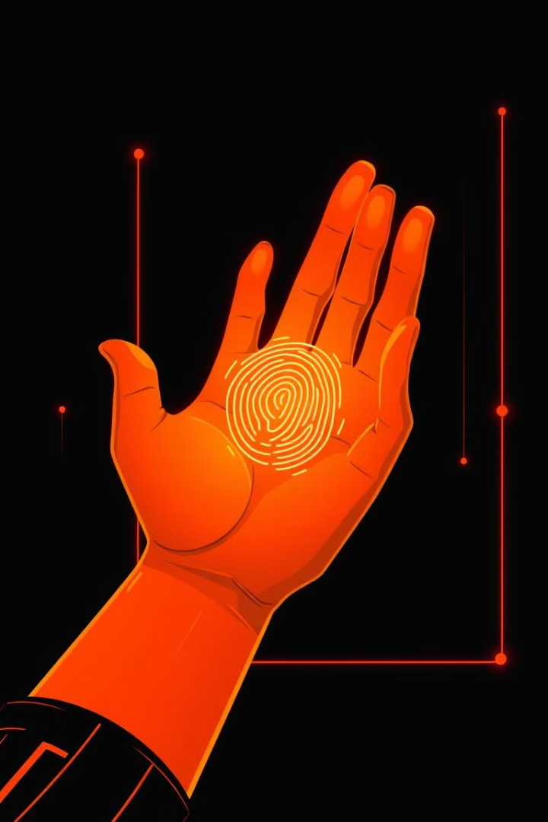
Key Takeaways: A Transformative Vision
Non-Invasive Approach
Improved Accessibility
Fingerprint-based blood group detection offers a significant advancement in medical diagnostics.
This technology has the potential to revolutionize healthcare in various settings.
Ethical Considerations
Responsible data management and model transparency are crucial aspects of this technology's implementation.

Slide 10
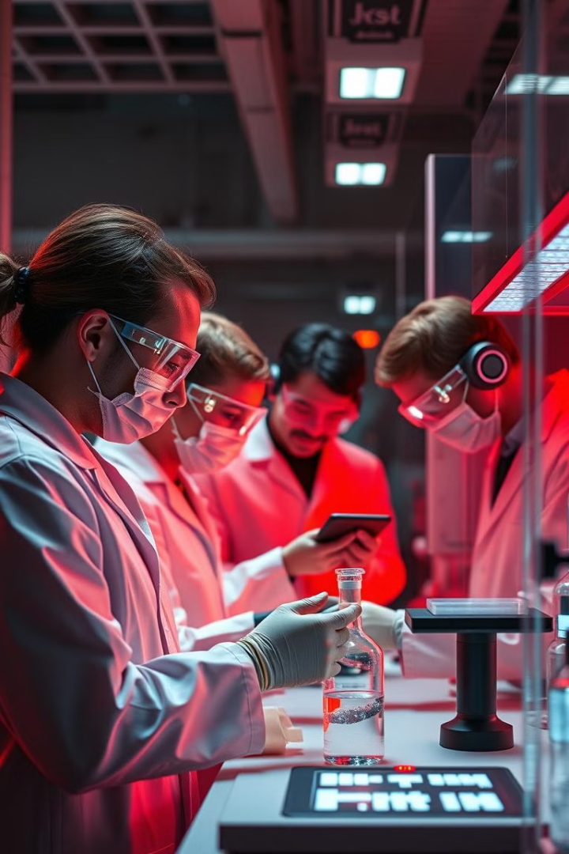

Next Steps: Towards a New Era of Blood Group Detection
Future research will focus on refining the model, addressing ethical considerations, and exploring real-world applications to bring this transformative technology to the forefront of healthcare.

Slide 11
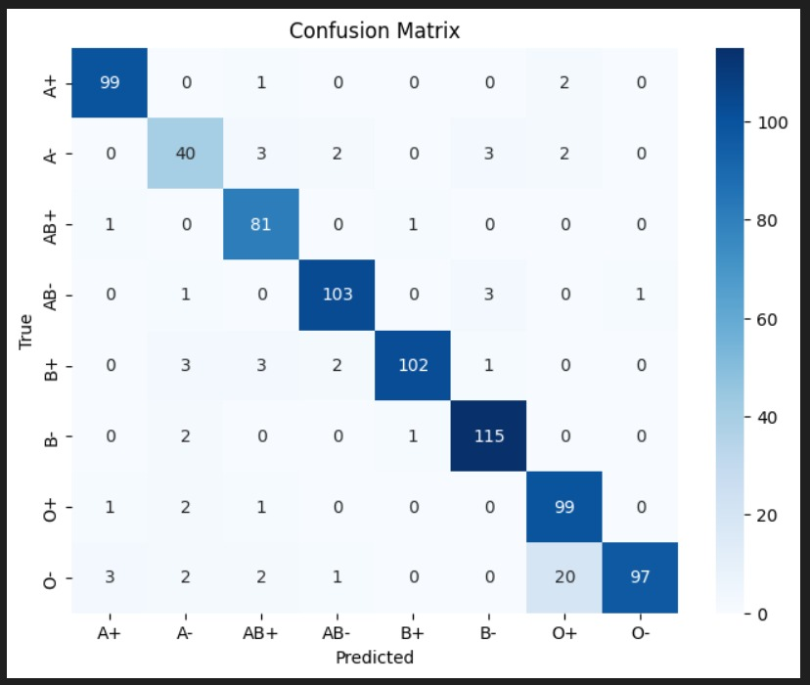
CONFUSION MATRIX
True Positive (TP): The model predicted "Positive", and the actual label was also "Positive". ✅ Correct positive prediction.
False Negative (FN): The model predicted "Negative", but the actual label was "Positive". ❌ Missed a positive case.
False Positive (FP): The model predicted "Positive", but the actual label was "Negative". ❌ Incorrectly marked a negative case as positive.
True Negative (TN): The model predicted "Negative", and the actual label was also "Negative". ✅ Correct negative prediction.

Slide 12
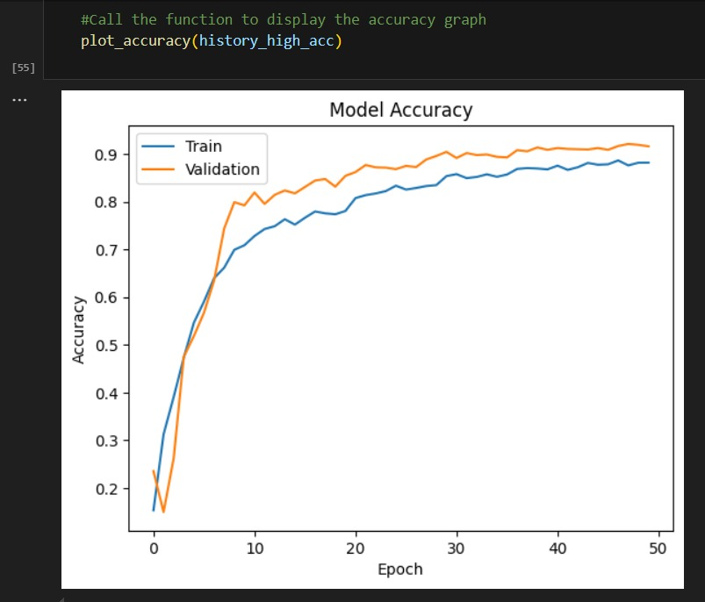
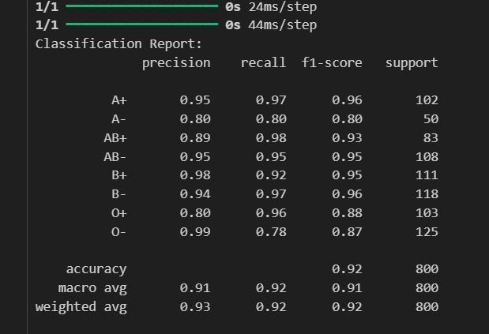

Results-
Test Set Evaluation: Access model performance on a separate test set using metrics…
Accuracy
Precision
Recall
Fl-score
Cross-Validation: Perform cross- validation to ensure the model's robustness and generalizability..

Slide 13


Rigorous Evaluation for Robust Performance
92%
94%
Accuracy
Precision
The model achieves high accuracy in classifying blood groups.
The model correctly identifies blood groups with minimal false positives.
93%
92%
Recall
F1-Score
The model effectively identifies all instances of each blood group.
The model demonstrates a high balance between precision and recall.

Slide 14
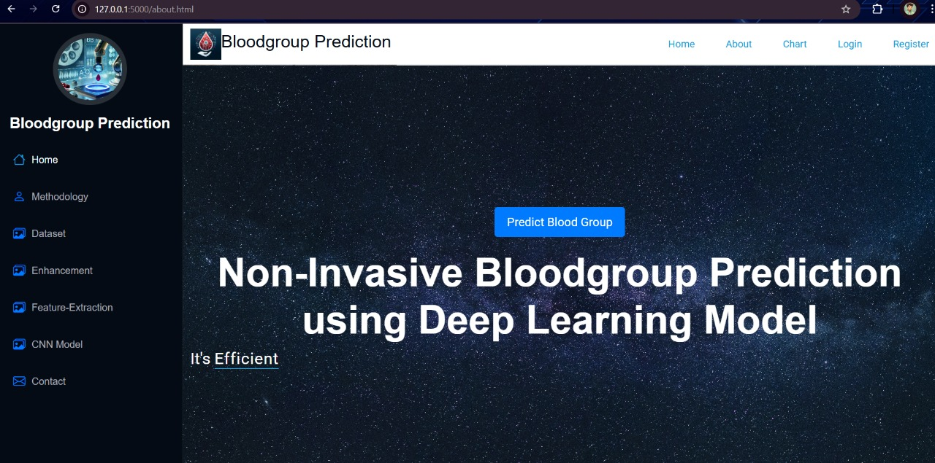
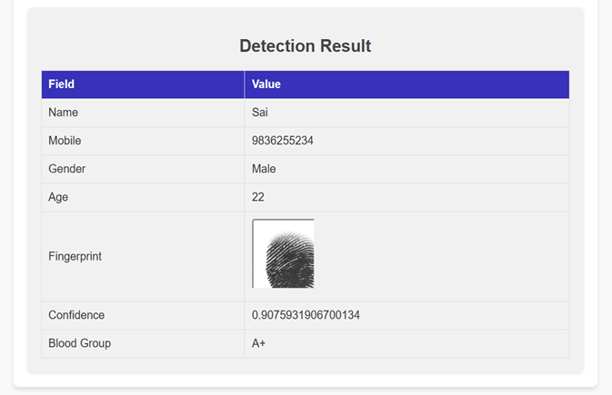
PRIDICT BLOOD GROUP PAGE
RESULT PAGE

Slide 15

References & Acknowledgments
This research builds on prior studies in fingerprint biometrics, blood group prediction, and machine learning. Key references include works by Mahmood and Kuppa (2010), Vijaykumar et al. (2021), and others exploring CNN applications in biometric identification and blood typing.
Extensive literature review and experimental validation underpin the system's development and performance analysis.

Slide 16





Thank You!

